Slide 1
Agile in a Highly Regulated Organization
Tami Flowers
KCDC - May 15, 2014

Slide 2
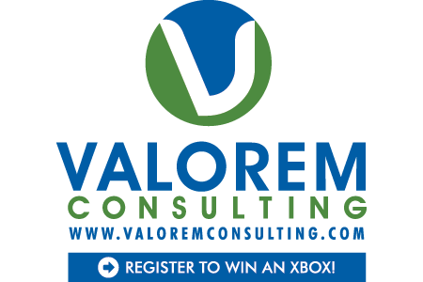



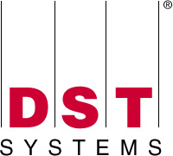



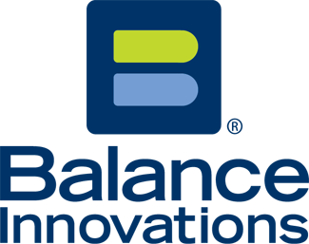

























Titanium Sponsors
Platinum Sponsors
Gold Sponsors

Slide 3
Highly Regulated Environment
I worked for a company with these words in it’s name:
Federal
Home Loan
Bank
That meant we had to consider
Sarbanes Oxley Act (SOx)
COBIT
= internal auditors, external auditors, internal risk management group, examiners
= 6-9 months a year of being audited or examined

Slide 4
Today’s Discussion
Why did some of these regulations come about?
What do COBIT and SOx say?
Ok, so what does that mean?
Where to start
What to do on a project
Tips and lessons learned
Implementing new or changed regulations

Slide 5
regulation
Our friends at wikipedia say:
A regulation is a rule or law designed to control or govern conduct.
Regulation creates, limits, constrains a right, creates or limits a duty, or allocates a responsibility.

Slide 6
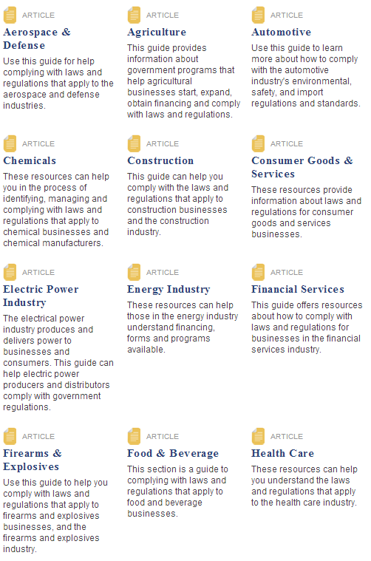
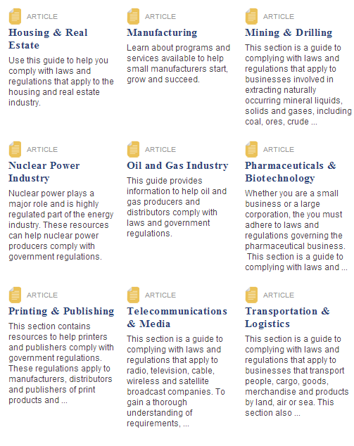
Most industries and businesses have regulations

Slide 7
enron
Before its bankruptcy on December 2, 2001, Enron employed approximately 20,000 staff and was one of the world's major electricity, natural gas, communications, and pulp and paper companies, with claimed revenues of nearly $101 billion during 2000. Fortune named Enron "America's Most Innovative Company" for six consecutive years.
At the end of 2001, it was revealed that its reported financial condition was sustained substantially by an institutionalized, systematic, and creatively planned accounting fraud.
The scandal also brought into question the accounting practices and activities of many corporations in the United States and was a factor in the creation of the Sarbanes–Oxley Act of 2002.
Arthur Anderson was dissolved, shareholders lost, employees lost their jobs and retirements.

Slide 8
What is sOx?
SOx
Sarbanes-Oxley; Senator Paul Sarbanes and Rep Michael Oxley
Aka “Public Company Accounting Reform and Investor Protection Act”
Thank you Enron, Tyco, and WorldCom
Contains 11 titles, or sections, ranging from additional corporate board responsibilities to criminal penalties, and requires the Securities and Exchange Commission(SEC) to implement rulings on requirements to comply with the law
Controls, assessment of internal controls, disclosures in reports, audits, etc.
Controls around anything that impacts what goes onto a financial statement

Slide 9
Types of controls
Business units
Any business department that impacts financial statements
Accounting
Finance
HR (executive compensation, etc.)
IT
IT general controls
IT application controls

Slide 10
It controls
Our friends at wikipedia say:
IT control objectives relate to the confidentiality, integrity, and availability of data and the overall management of the IT function of the business enterprise.
IT controls are often described in two categories: IT general controls and IT application controls.

Slide 11
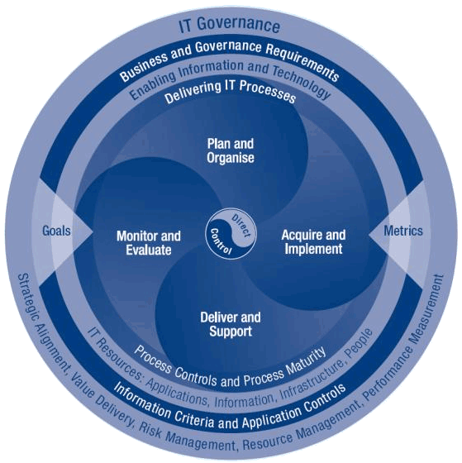
cobit
Framework for IT Governance and Control
Policy development and good practices for IT control
“COBIT emphasizes regulatory compliance, helps organizations to increase the value attained from IT, enables alignment and simplifies implementation of the enterprises' IT governance and control framework.”

Slide 12
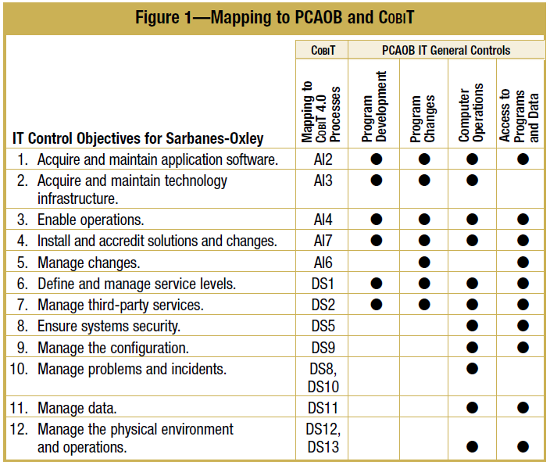
In all, 12 IT control objectives, which align to the Public Company Accounting Oversight Board
(PCAOB) Auditing Standard No. 2 and Control Objectives for Information and related Technology (COBIT ®), were defined for Sarbanes-Oxley. Figure 1 provides a high-level mapping of the IT control objectives for Sarbanes-Oxley described in the IT Control Objectives for Sarbanes Oxley , 2nd edition document, IT general controls identified by the PCAOB and the COBIT 4.0 processes.
Notes:
Public Company Accounting Oversight Board

Slide 13
IT Governance Institute
From the April 2004 issuance of IT Control Objectives for Sarbanes-Oxley:
“The work required to meet the requirements of the Sarbanes-Oxley Act should not be regarded as a compliance process, but rather as an opportunity to establish strong governance models designed to result in accountability and responsiveness to business requirements. Building a strong internal control program within IT can help to:
Gain competitive advantage through more efficient and effective operations
Enhance risk management competencies and prioritization of initiatives
Enhance overall IT governance
Enhance the understanding of IT among executives
Optimize operations with an integrated approach to security, availability and processing integrity
Enable better business decisions by providing higher-quality, more timely information
Contribute to the compliance of other regulatory requirements, such as privacy
Align project initiatives with business requirements
Prevent loss of intellectual assets and the possibility of system breach”

Slide 14
Things to consider from the IT Governance Institute
Some of the important areas of responsibility for IT include:
Understanding the organization’s internal control program and its financial reporting process
Mapping the IT environment (IT services and processes) that supports internal control and the financial reporting process to the financial statements
Identifying risks related to these IT systems
Designing and implementing controls designed to mitigate the identified risks and monitoring them for continued effectiveness
Documenting and testing IT and systems-based controls
Ensuring that IT controls are updated and changed as necessary to correspond with changes in internal control or financial reporting processes
Monitoring IT controls for effective operation over time
Participating in the Sarbanes-Oxley project management office

Slide 15
What Does this Mean?
Controls, not the HOW or the process, is the focus.
As long as your process can show
the controls,
that the controls are implemented and tested
Then the process you use to build software is up to you and your organization.

Slide 16
Project Lifecycle
Feasibility
Release Planning
Iterate
Close Out
Initiation

Slide 17
Map Controls to Project Lifecycle
 | Feasibility | Initiation/Planning | Iterate | Close Out
COBIT | Prioritization of Requests | Project Approvals Testing & Documentation Approach | Project Status Reporting Testing Documentation and Sponsor Approvals Security Review - least privileges in an application Security Testing Documentation | Change Management Approvals Cycle 0 Testing Documentation Cycle 0 Security Testing Documentation Code Storage
SOx | Prioritization of Requests | Testing & Documentation Approach | Testing Documentation and Sponsor Approvals Security Review – least privileges in an application Security Testing Documentation | Change Management Approvals Cycle 0 Testing Documentation Cycle 0 Security Testing Documentation Install Documentation

Slide 18
Say What You are Going to Do, and Do It
Use your SDLC to define your project process and deliverables.
Ensure those deliverables are created for each project.
Make sure they are stored where they can be easily found when requested by auditors and examiners.

Slide 19
One Size May Not Fit All
One size of Agile may not be right for all types of projects and teams.
For large longer-term projects, daily standups, release plans, iteration planning meetings, retrospectives may be required with stories and tasks located on a project board.
An infrastructure team charged with installing servers, routers, and firewalls and keeping it all up and running may have an overall plan and daily standups with tasks as sticky notes on a Kanban board.

Slide 20
Consider Using Service Levels
Consider adding different Service Levels, with increasing types of deliverables, based on project characteristics.
For instance, a year long project with a larger project team should have far more controls and deliverables than a 1 week project with one developer.
Don’t have an overwhelming number of deliverables so it takes longer to do paperwork or document than it does to do the project.
Want to learn more? Stay for my next session!

Slide 21
During a Project
Identify SOX controls up-front during the early stages of project planning.
When creating test scripts, explicitly identify the SOX controls that need to be tested.
After testing, explicitly document that those controls were tested. This doesn’t mean provide pages of documentation; identify what you are testing, test it, and document that you tested it. A test scenario can be documented with a simple “pass” or “fail”.

Slide 22
Keep it Simple!
Stay tool-agnostic. Don’t tie yourself to specific tools when documenting your processes. Keep development environments, bug tracking software, testing tools, etc. out of the documentation.

Slide 23
Implementing regulatory changes
It’s rare that you know exactly what the regulation states until right before it’s supposed to be implemented
Use time once you know about the reg until you know exactly what it states to:
Research what it means
Talk with regulators to understand it’s impacts, if possible
Identify applications that need changed/created to implement the regulation
Work with the product owner(s) to identify highest risks and value, prioritize work that you can upfront
Agile helps you be flexible to make adjustments once you get the final ruling, regulations, etc.

Slide 24
Lessons Learned
Your SDLC should guide your deliverables. Keep it updated and “fresh”. Consider updating it and training your team members annually.
Focus on deliverables that prove the controls have been tested.
Don’t overdo it on deliverables. Keep it as simple as possible.
Work to educate auditors, examiners, etc. on what Agile means.
When possible, include them early in the development of your process.
Say what you are going to do…and do it! Then make sure it’s saved and easy to find when asked.

Slide 25
Me
Twitter: TamiLFlowers
LinkedIn: Tami Flowers
Slideshare: www.slideshare.net\tamiflowers
Thanks!

